Slide 1
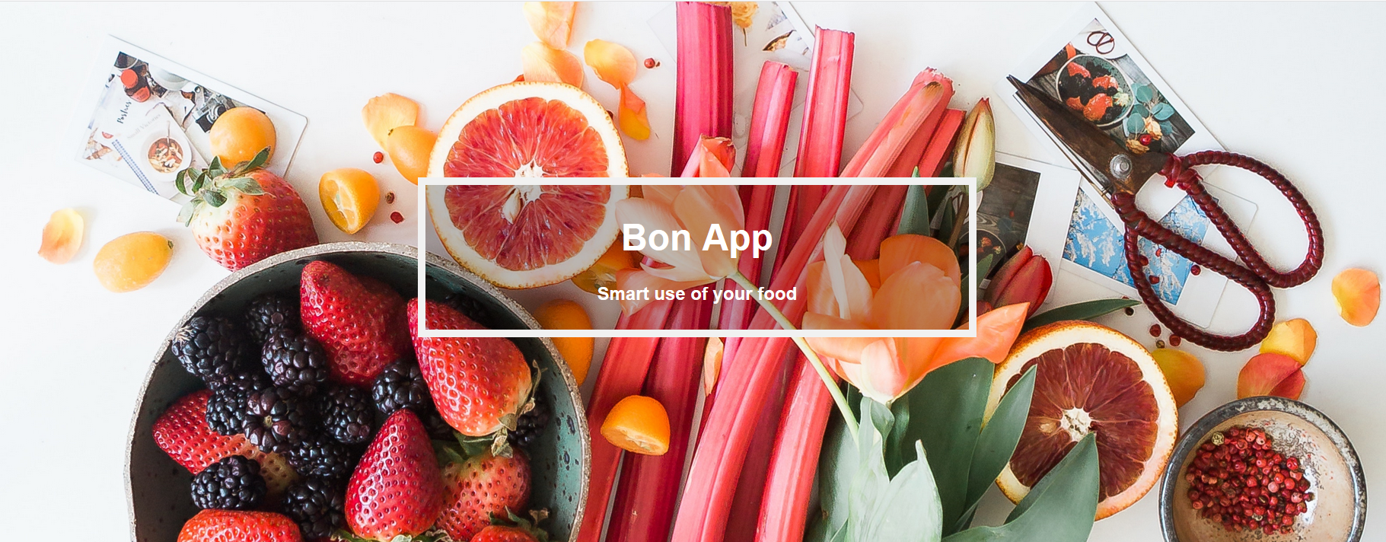
Project: Hackmeat
25. November 2018

Slide 2
Table of Content
Use Cases
Live Demo
Challanges
Technically

Slide 3

Use Cases
As a hungry monster I want a recipe, based on ingredients I have at home and filter them by personal preferences.
As a hungry monster I want a shopping-list of the ingredients I have to buy, based on the recipe I choose.
As a lazy monster I want to scan my bill to add my shopping to the stock list.

Slide 4
Live Demo

Slide 5
Challenges
Big Team

Slide 6

Technically
GUI
Post Picture
Bill scanner
Get Stocke
Post Shopping
Post Shopping
Search Service
DB-Service
Algolia
Post Items into the Stock
Recipes
Incredients
Stock

Slide 7
Question?

